Slide 1
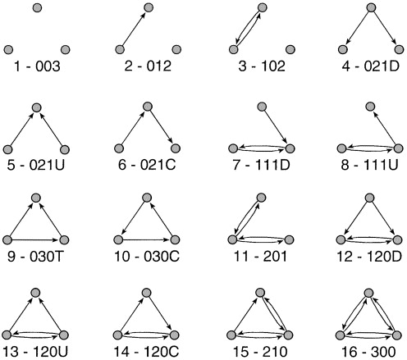
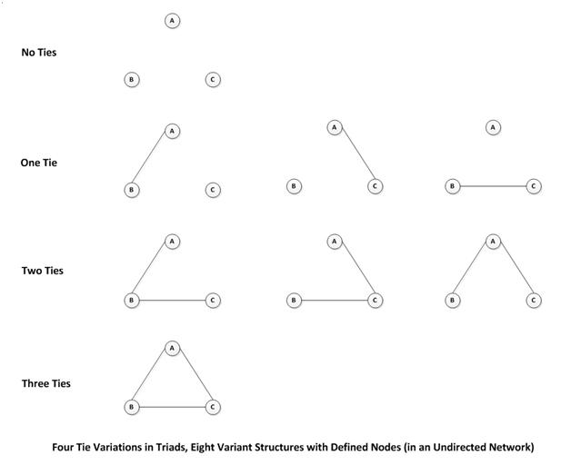
Triad Census

Slide 2

Structural balance theory
Building blocks
  A set of actors
  A set of (directed) relationships defined on those actors
  For example: Likes and Dislikes

Slide 3
Structural balance theory
Considering triads containing directional arcs
  This is the key to balance theory
    Solid lines are positive sentiments
    Null (dashed) lines are negative sentiments

Slide 4
Structural balance theory
In structural balance theory, each vertex in the configuration is given a designation
  Person (P): "The individual whose behavior is being predicted by the theory" (Davis 1963: 445).

Slide 5
Structural balance theory
In structural balance theory, each vertex in the configuration is given a designation
  Other (O): An object (e.g another individual) towards which P is oriented.

Slide 6
Structural balance theory
In structural balance theory, each vertex in the configuration is given a designation
  Q: A third object (a value, group or another individual) towards which P and O are oriented.

Slide 7
Structural balance theory
The basic premise of the theory is that people are motivated to seek balance in the triadic configurations in which they are embedded.

Slide 8
Structural balance theory
Balance is formally defined as the sign of the product of the weights attached to each edge in the cycle.
  Positive triads are balanced
  Negative triads are imbalanced

Slide 9
Structural balance theory
PQ |  | OQ |  | PO |  | POQ

Slide 10
Structural balance theory
Balance is formally defined as the sign of the product of the weights attached to each edge in the cycle.
  Balance reduces “tension” and is experienced as satisfactory (stable equilibrium)

Slide 11
Structural balance theory
Balance is formally defined as the sign of the product of the weights attached to each edge in the cycle.
  Imbalance is experienced as tension and discomfort (unstable state) that must be resolved (balanced)

Slide 12

Structural balance theory
Balance is formally defined as the sign of the product of the weights attached to each edge in the cycle.
  Imbalance is experienced as tension and discomfort (unstable state) that must be resolved (balanced)

Slide 13
Structural balance theory
Balance is formally defined as the sign of the product of the weights attached to each edge in the cycle.
  Imbalance is experienced as tension and discomfort (unstable state) that must be resolved (balanced)
Republican Party
You
Clint Eastwood

Slide 14
Structural balance theory
Balance is formally defined as the sign of the product of the weights attached to each edge in the cycle.
  Imbalance is experienced as tension and discomfort (unstable state) that must be resolved (balanced)
Taxes
Americans
Public Education

Slide 15
Structural balance theory
Balance "rules"
  If P likes O, and O likes Q, P likes Q
  If P likes O, and O dislikes Q, P dislikes Q
  If P dislikes O, and O likes Q, P dislikes Q
  If P dislikes O and O dislikes Q, P likes Q

Slide 16
Structural balance theory
Balance "rules"
  If P likes O, and O likes Q, P likes Q
  If P likes O, and O dislikes Q, P dislikes Q
  If P dislikes O, and O likes Q, P dislikes Q
  If P dislikes O and O dislikes Q, P likes Q

Slide 17
Structural balance theory
Balance "rules"
  If P likes O, and O likes Q, P likes Q
  If P likes O, and O dislikes Q, P dislikes Q
  If P dislikes O, and O likes Q, P dislikes Q
  If P dislikes O and O dislikes Q, P likes Q

Slide 18
Structural balance theory
Balance "rules"
  If P likes O, and O likes Q, P likes Q
  If P likes O, and O dislikes Q, P dislikes Q
  If P dislikes O, and O likes Q, P dislikes Q
  If P dislikes O and O dislikes Q, P likes Q

Slide 19

Structural balance theory
Considering relations of multiple others in relation to the same object can lead to more complex mixtures of balance and imbalance:
  The “cross-pressure” situation
Q

Slide 20
Structural balance theory
Cartwright and Harary (1956) proved that if all of the triads in a signed value matrix are balanced, then
  The matrix can be blocked into two mutually exclusive groups such that:
  All edges with positive weights are within blocks
  All edges with negative weights are between blocks.

Slide 21
Structural balance theory
This "structural balance" formalizes a key intuition between balance processes at the micro-level and macro-level group structure
  Balance seeking at the micro-level leads to group polarization at the macro-level

Slide 22

Structural balance theory
Q(liberal tweet)
P(liberal retweeter)
O(liberal tweeter)

Slide 23
Causes of transitivity
Balance theory is concerned with the origins not the consequences of transitivity
  Cognitive or emotional pressures on a focal person
  A likes B and A likes C, so B and C like each other
The sociological theory of foci (Feld) relies on a completely contextual mechanism
  A meets both B and C because all three participate in same common activity
Granovetter’s SWT theory relies on the “strength” mechanism:
  If A and B have a strong tie and B and C also have a strong tie it is likely the A and C will have at least a weak tie
Notes:
Foci discussed in lecture on composition of ego networks

Slide 24
Causes of transitivity
Heider’s Balance theory
  Unbalanced triad
  Ego feels psychological pressure
  Ego relieves pressure by closing the open triangle
    Mechanism: Ego-driven link formation
Psychological Pressure

Slide 25
Causes of transitivity
Feld’s Focus theory
  Empty triad
  Actors participates in common focus/joint activity
  Closed triad (3-clique)
    Mechanism: Context-driven link formation
Common Focus

Slide 26
Causes of transitivity
Granovetter’s SWT theory
  Unbalanced triad with either strong or weak links
  Depending on strength
  Triad will either close or remain open
    Mechanism: Strength-driven link formation
Strength Effect?

Slide 27
Causes of transitivity
Granovetter’s SWT theory
  Unbalanced triad with either strong or weak links
  Depending on strength
  Triad will either close or remain open
    Mechanism: Strength-driven link formation
No Strength Effect?

Slide 28
Causes of transitivity
Open questions:
  Are psychological “pressures” towards balance enough?
  Do triads always require a common focus of activity to remain “closed”?
  Is strength a determinant or a consequence of triadic structure?
Krackhardt’s Simmelian tie theory:
  Incorporates insights from SWT but abandons pure ego or dyad-driven mechanisms
  Conceptualizes the triad as its own special focus of activity
  Triads have “top-down” effects on the dyads that compose them

Slide 29
Why are triads so special?
Simmelian Tie Theory:
  Triads are qualitatively different from dyads
  Dyads embedded in reciprocally strong triangles are not the same as standalone dyads
    People in a standalone dyad are more “their own person”
      Have more individuality
      More potential for unresolved differences
    People in an embedded (Simmelian) dyad can be “outvoted”
      Hence more likely to conform to the “group”
      Less individuality and autonomy

Slide 30
Why are triads so special?
    People are “power-symmetric” in a standalone dyad:
      If either withdraws relationship dissolves
    Any one ego experiences “power-asymmetry” (dependence) in an a triad:
      S/he can withdraw but the other two people still have a relationship
      S/he loses the benefits of two relationships
        Each other ego only loses one

Slide 31
Why are triads so special?
    This explains why conflict is more difficult to settle in standalone dyads
    Also explains why sometimes the only conflict resolution recourse is to turn the standalone dyad into a “temporary” Simmelian dyad:
      Arbitration
      Mediation
    Research shows that third parties are useful in alleviating dyadic conflicts

Slide 32
Why are triads so special?
    Implication:
      Networks with closed triads can have two (mutually exclusive) types of ties:
        Simmelian ties
        “Regular” (non-Simmelian) ties
    This means that you could “split” the two networks and analyze them separately
    Non-Simmelian ties could either be “disembedded” dyads or dyads embedded in weak triads

Slide 33
Why are triads so special?
Consequences of Simmelian Tie Theory:
  Simmelian ties are more durable and/or resistance to disruption than non-Simmelian ties
  Simmelian ties are relatively common given baseline graph theoretic expectations (e.g. number of nodes number of links)
  When a person is a “broker” between two cliques to which s/he is linked to via Simmelian ties there is a tradeoff between bridging and multiple norm constraint
  Pure “structural holes” broker must keep non-Simmelian relations to be effective
    But sacrifices trust

